Slide 1
DIGITAL LOGIC · XOR GATES
Design and Simulation of a Digital
Even and Odd Parity Generator
Using XOR Gates
A concise circuit study
Notes:
Introduce parity as a small circuit with a clear job: add one bit that helps detect errors. The deck starts with the idea, then builds the XOR chain, verifies it with a truth table, and ends with what the Logisim simulation makes visible.

Slide 2



01 · WHY PARITY
Parity adds one bit of error-detection power
A parity bit gives the receiver a quick check on whether the received data still has the expected count of 1s.
Count the 1s
Spot a mismatch
Split the work
Parity checks whether the number of 1s in a data word is even or odd.
A single parity bit helps a receiver detect many one-bit errors.
The generator creates the bit before transmission; the checker validates it after reception.
Notes:
Parity is not a correction method. It is a quick consistency check. The sender creates the extra bit, and the receiver checks whether the total pattern still follows the agreed rule.

Slide 3
02 · THE BUILDING BLOCK
XOR turns a count into a signal
A | B | A XOR B
0 | 0 | 0 · same
0 | 1 | 1 · different
1 | 0 | 1 · different
1 | 1 | 0 · same
XOR outputs 1 when its inputs are different. For two inputs, that means exactly one input is 1.
ONE 1 → OUTPUT 1
Chain XOR gates and the output keeps track of whether the number of 1s is odd or even.
Notes:
Start with the two-input rule. The gate does not count with a number display; it compresses the count into one bit. Different inputs produce 1, while matching inputs produce 0.

Slide 4
03 · THREE INPUTS
Three inputs become one parity equation
For data bits A, B, and C, the odd-parity bit is:
A ⊕ B
(A ⊕ B) ⊕ C
Odd P
First XOR compares the first two data bits.
Second XOR combines that result with C.
P is 1 when the data contains an odd number of 1s.
Example: for A=1, B=0, C=1, the two 1s cancel through XOR, so P=0.
Notes:
Build the expression from left to right. The first gate combines A and B. The second gate combines that intermediate result with C. For 101, there are two 1s, so the odd-parity output is 0.

Slide 5
04 · TWO PARITY CONVENTIONS
Even and odd parity use the same core
The XOR chain does the counting. Only the final choice of output changes.
ODD PARITY
EVEN PARITY
Keep the XOR result
Invert the XOR result
Choose P so the total number of 1s is odd. The XOR result already gives the required bit.
Choose P so the total number of 1s is even. A NOT gate, or an XOR with constant 1, creates the complement.
XOR result → NOT → Even P
Data 101 → P = 0
Two data 1s plus P=0 remains even, so for odd parity this example requires P=1.
Notes:
Clarify the shared core. The XOR chain does not need to be rebuilt for the two conventions. Odd parity uses the chain output; even parity complements it. When discussing 101, remember that two data 1s already make an even count, so odd parity adds 1 while even parity adds 0.

Slide 6
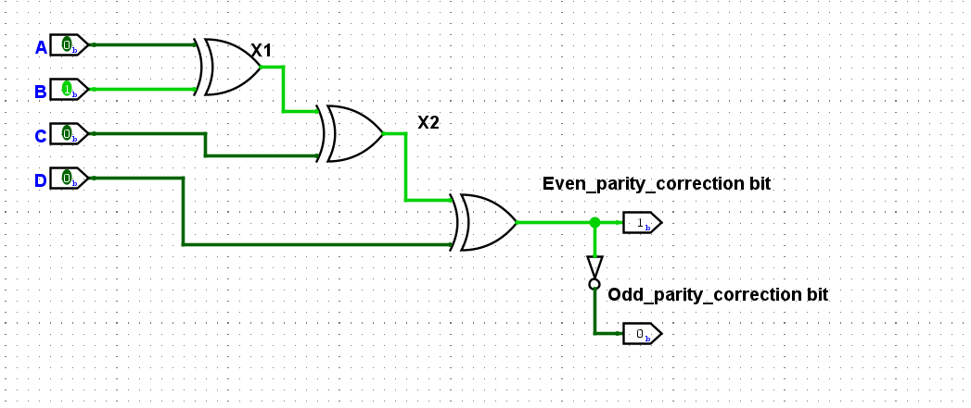
05 · LOGISIM BUILD
Build the circuit in Logisim
Use two XOR gates for the three-input core, then add the complement path for even parity.
Signal path: A, B → XOR → XOR with C → odd P → inverter → even P
Notes:
Build in the order shown. First establish the three inputs. Then create the XOR chain and label its output as odd P. Finally add the inverter only when the even-parity output is needed.

Slide 7
06 · VERIFICATION
Use the truth table to verify every case
Toggle each input in Logisim and compare the output with the expected parity column.
A B C | A XOR B XOR C | Odd P | Even P | A B C | A XOR B XOR C | Odd P | Even P
000 | 0 | 0 | 1 | 100 | 1 | 1 | 0
001 | 1 | 1 | 0 | 101 | 0 | 0 | 1
010 | 1 | 1 | 0 | 110 | 0 | 0 | 1
011 | 0 | 0 | 1 | 111 | 1 | 1 | 0
The odd and even columns are complements: each input combination has one output of 1.
Notes:
Read the rows as a complete test, not as selected examples. Every possible three-bit input appears once. The XOR column matches odd P, while even P is its complement.

Slide 8
07 · TAKEAWAYS
What the simulation teaches
XOR reveals oddness
XOR gates naturally detect whether the count of 1s is odd.
The circuit makes a Boolean rule visible: change an input, and the parity output responds immediately.
Inversion changes the rule
Complementing the result switches between odd and even parity.
Simulation closes the loop
Logisim makes the Boolean rule visible: inputs change, and the parity output responds immediately.
INPUTS → XOR CHAIN → PARITY OUTPUT
Notes:
Close by connecting the three observations. XOR is the natural odd-count detector. An inverter switches the convention. Logisim turns the equation into something you can toggle, observe, and verify against the truth table.

